Slide 1
AI Fundamentals for Non-Data Scientists
Specific Machine Learning Methods: A Deep Dive
Kartik Hosanagar, Professor of Operations, Information and Decisions

Slide 2
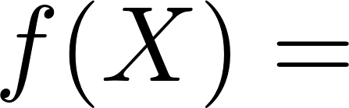

A Closer Look at ML Methods
All different ways of approximating the relationship between X and y
Logistic regression
Decisions trees and random forests
Neural nets

Slide 3
Logistic Regression
Used for binary classification, i.e. when outcomes can take only 1 of 2 values (yes/no, click/no click, health/sick)
Among the most useful and popular methods (along with ordinary least squares) in all of statistics, data science, academia
Is it really machine learning?
Early development in 19th century

Slide 4
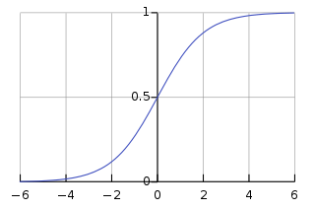
Logistic Regression
Goal is to estimate the probability of a given outcome, conditional on some variables (x):
Logit function constrains probabilities to between 0 and 1

Slide 5
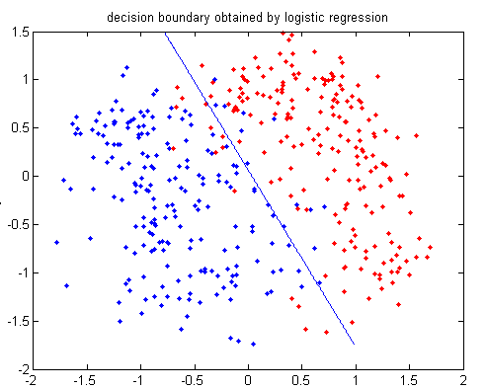
Logistic Regression
Equivalent to finding the “best-fit” line/plane that separates the data
Example: How do age and income predict whether a customer will purchase your new product?
Red dots: purchase
Blue dots: no purchase

Slide 6
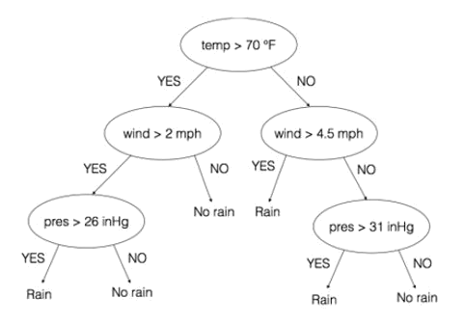
Decision Trees
Easy-to-interpret models built by iteratively looking for features in your data that are most predictive
Example:
Output: Will it rain or not today?
Inputs: Temperature, wind, pressure

Slide 7
Decision Trees
Question: How to decide which variables to split on at each branch? (e.g. consider temperature or pressure first?)
Also, how to select what value to split on?
e.g. 70 degrees vs. 60 degrees
Mathematical Answer: Select variables/splits that minimize “entropy” of the dataset
In simple terms, choose a variable/ split that provides the most predictive power at each step
A “greedy” algorithm that looks for the best split at each step in the process
Continue to split branches on different variables until a desired level of depth or data size limits are reached

Slide 8
Random Forests
An “ensemble” algorithm that harnesses the power of many decision trees
Very popular, powerful and relatively simple ML algorithm
Basic idea:
Take many random samples of your dataset
For each subset of data, train a decision tree (for each node in tree, only use a random subset of features)
To make final decision, treat each decision tree as a “vote” and choose the prediction with the most votes among all sub-trees

Slide 9
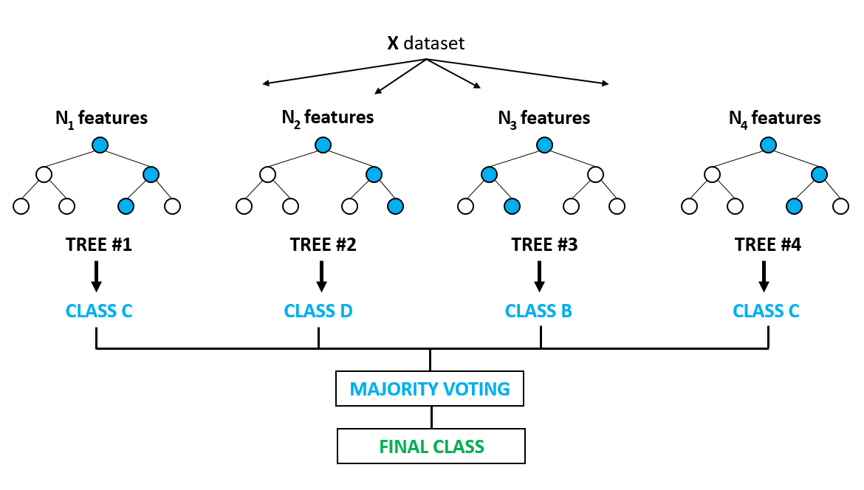
Random Forests

Slide 10
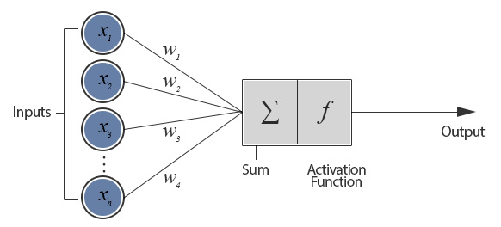
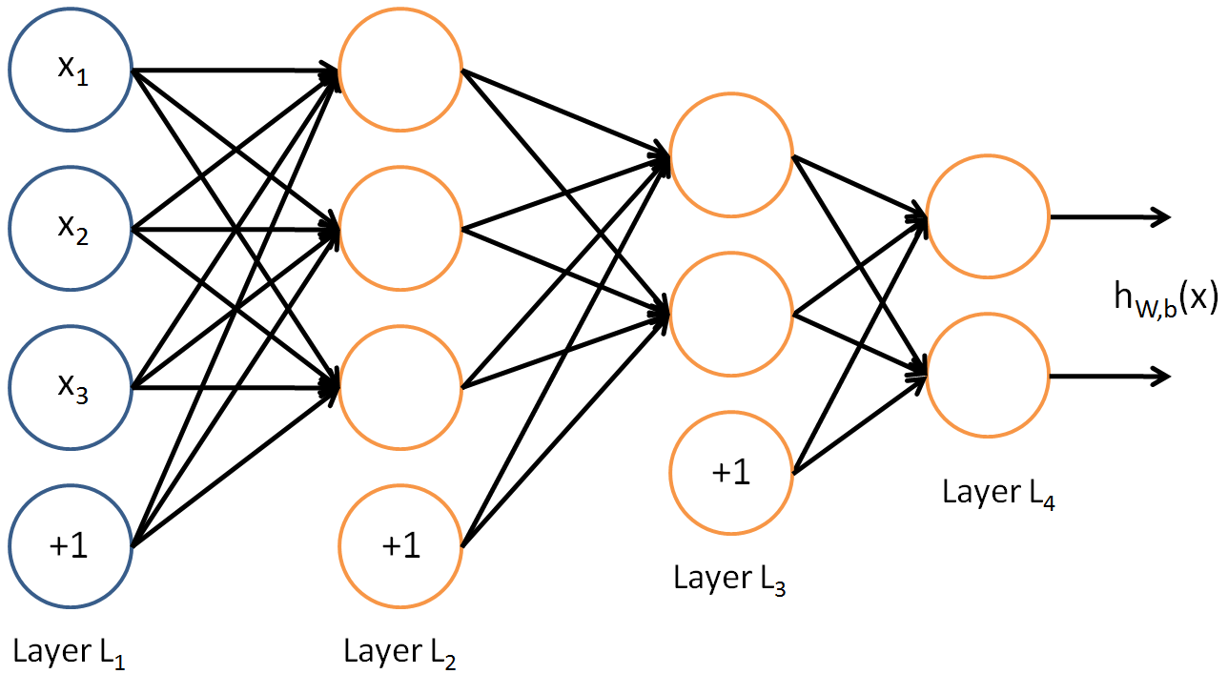
Neural Networks (NNs)
Loosely inspired by biological neurons
Neurons take input from other neurons, apply transformation & pass signal on
Single “Neuron”
“weights”
“parameters”
Deep Neural Net

Slide 11
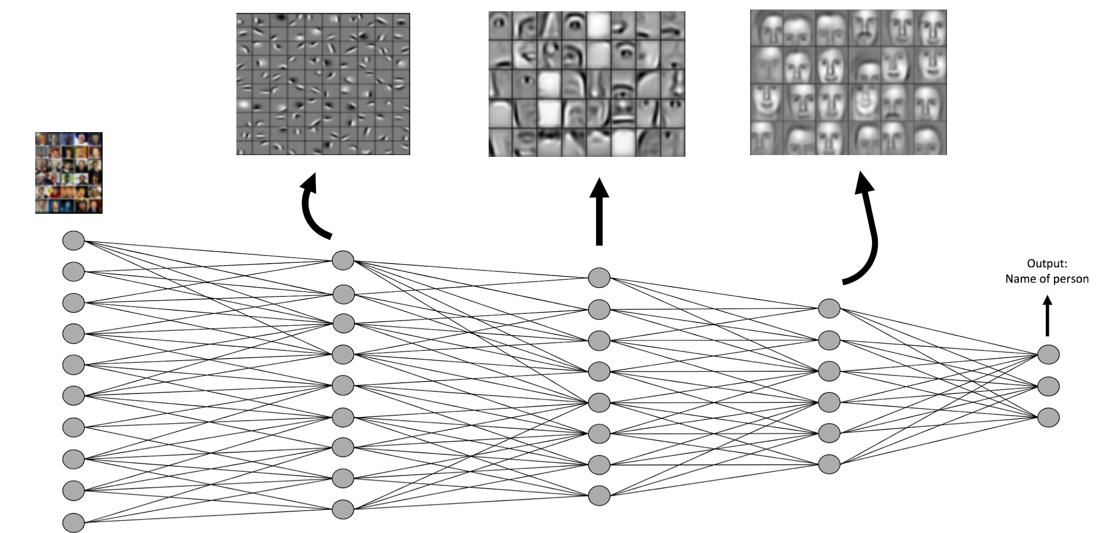
Neural Network for Face Recognition
See https://www.youtube.com/watch?v=aircAruvnKk for a simple video tutorial

Slide 12
Neural Networks (NNs)
Layers of a deep neural network
Input layer: Neurons correspond to the RGB value of all the pixels in the image
Final layer has the outputs we expect (e.g. 3 neurons corresponding to three different people who are going to be identified)
Hidden layers in between
See https://www.youtube.com/watch?v=aircAruvnKk for a simple video tutorial

Slide 13
Neural Networks (NNs)
NNs have become very successful in recent years
Are often among the best algorithms in top ML competitions (especially with images, audio, video, etc.)
Why?
Lots of parameters = ability to build very complex models
Recent advances in computation (GPUs) and algorithms (backpropagation) has allowed for more layers (more complex models)
NNs are hard to understand and interpret
We know inputs and outputs, but the middle layers are merely numbers from our point of view
Lots of work is being done to “open up” black box models so we can understand what they are doing

Slide 14
Other ML Methods
Boosting
Support vector machines (SVM)
Neural nets - much more complicated and varied than covered here
Many, many other regression techniques
LASSO, Ridge, weighted regression, kernel regression
Want to learn more?
Statistics or Intro CS courses on machine learning

Slide 15
AI Fundamentals for Non-Data Scientists
Intro to Model Selection
Kartik Hosanagar, Professor of Operations, Information and Decisions

Slide 16
Model Selection
For any prediction problem, there are many algorithms and methods available - decision trees, random forests, neural networks, and more
Model evaluation and selection is done by evaluating model performance on a validation dataset
Holdout validation: Partition available data into a training dataset and a holdout; evaluate model performance on holdout
Cross-validation: Create a number of partitions (validation datasets) from the training dataset; fit model to the training dataset (sans the validation data); evaluate model against each validation dataset; repeat with each validation set and average results to obtain the cross-validation error

Slide 17
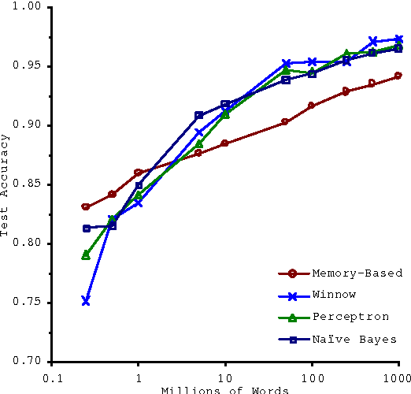
Data vs. Model
Often Data > Methods
Microsoft researchers (Banco and Brill) evaluated performance of multiple models for a language understanding task
Varied size of training dataset (up to 1B words)
Among modern methods, performance differences between algorithms are relatively small when compared to differences between same algorithms with more/less data
“Unreasonable effectiveness of data” – Peter Norvig (Google)

Slide 18
AI Fundamentals
Feature Engineering and Deep Learning Introduction
Prasanna (Sonny) Tambe, Associate Professor of Operations, Information and Decisions

Slide 19
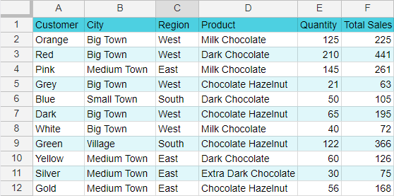
What About Unstructured Data?
Big revolution in AI is ability to predict from “unstructured data”
Decision

Slide 20
What About Unstructured Data?
When data are not structured, features have to be “engineered” from the data
A time-consuming and challenging process, and often requires domain expertise
One of the most difficult parts of the ML process, where data scientists spend a lot of their time
Can be as much an art as a science

Slide 21
Feature Engineering
Example: Features you might you engineer from real estate pictures
Take individual images and extract individual features
Requires knowledge of real estate
Requires access to a realtor and a software developer
Good amount of guessing involved — very likely to miss critical features

Slide 22
AI Fundamentals
Deep Learning
Prasanna (Sonny) Tambe, Associate Professor of Operations, Information and Decisions

Slide 23
Deep Learning
When working with unstructured data, requires a feature engineering step to generate features for the model
If the performance is too large or unacceptable, engineers try a new set of features or adjust features used in the current model
Domain expertise is still required
What are the right features to extract?
Can be especially hard when using unstructured data like images, sounds, or essays

Slide 24
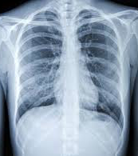
Example: X-Ray Diagnostics

Slide 25
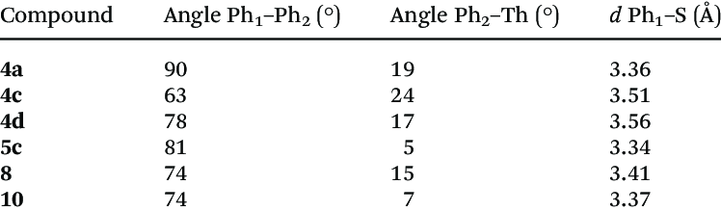
Example: X-Ray Diagnostics
Domain experts

Slide 26
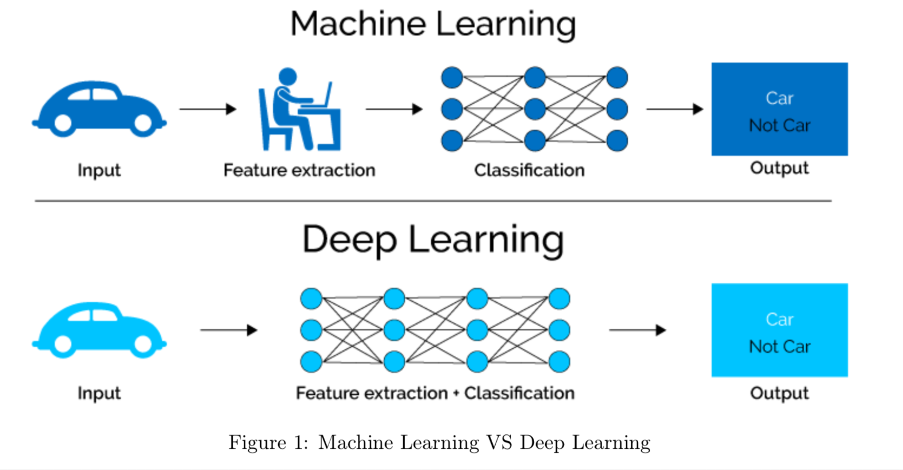
Deep Learning
Eliminates the need for feature extraction

Slide 27
Why is Deep Learning a “Game Changer”?
Feature engineering is expensive
Requires domain expertise, is error-prone, and is uncertain
Deep learning can lead to massive performance improvements, relative to hand-coded features
Computation is getting cheaper, making deep learning more feasible
Going to let us predict from unstructured data (images, online reviews, health data, audio, etc.) at scale
For any prediction or classification task, this is going to be an application of substituting more and more data (labeled examples) for expertise

Slide 28
Deep Learning Examples
Image recognition
Detecting fake news
Detecting knockoffs from luxury products

Slide 29
AI Fundamentals
Evaluating ML Perfomance
Prasanna (Sonny) Tambe, Associate Professor of Operations, Information and Decisions

Slide 30
Evaluating ML Performance
What should we tell the algorithm to optimize on?
Lost/cost functions
Accuracy
Precision
Recall
Specificity
Why are there so many?

Slide 31
Example: “Identify Fraudulent Credit Card Transactions”
Actual value | Predicted value
Fraudulent | Fraudulent
Legitimate | Legitimate
Legitimate | Legitimate
Legitimate | Legitimate
Fraudulent | Fraudulent
Fraudulent | Legitimate
Legitimate | Legitimate
Legitimate | Fraudulent
Legitimate | Legitimate
Legitimate | Legitimate

Slide 32
Example: “Identify Fraudulent Credit Card Transactions”
Actual value | Predicted value
Fraudulent | Fraudulent
Legitimate | Legitimate
Legitimate | Legitimate
Legitimate | Legitimate
Fraudulent | Fraudulent
Fraudulent | Legitimate
Legitimate | Legitimate
Legitimate | Fraudulent
Legitimate | Legitimate
Legitimate | Legitimate

Slide 33
Example: “Identify Fraudulent Credit Card Transactions”
Actual value | Predicted value
Fraudulent | Fraudulent
Legitimate | Legitimate
Legitimate | Legitimate
Legitimate | Legitimate
Fraudulent | Fraudulent
Fraudulent | Legitimate
Legitimate | Legitimate
Legitimate | Fraudulent
Legitimate | Legitimate
Legitimate | Legitimate

Slide 34
Evaluating ML Performance
Is the classifier doing a good job?
Depends on what we care about
Is it more costly to miss a fraudulent transaction?
Is it very costly to put a valuable customer’s credit card on hold accidentally?
There are different costs and benefits of getting different types of labels wrong in a prediction task

Slide 35
AI Fundamentals
How Deep Learning Works
Prasanna (Sonny) Tambe, Associate Professor of Operations, Information and Decisions

Slide 36
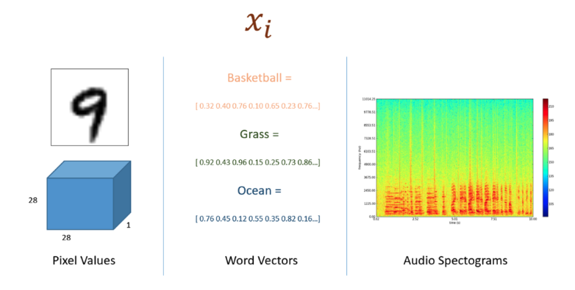
Unstructured Data
Unstructured data can be formulated into raw digital form

Slide 37
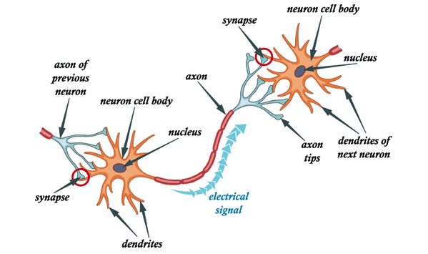
Unstructured Data
Unstructured data can be formulated into raw digital form
Data are then pre-processed to make it standardized for the prediction task
This data is passed into neural networks (modeled after neurons)

Slide 38
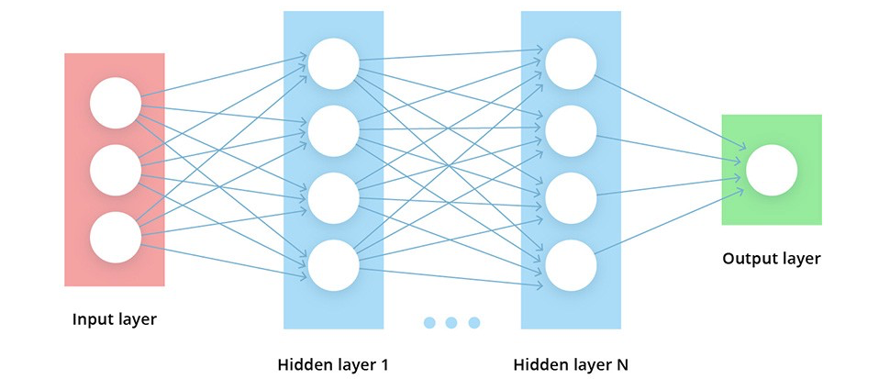
Neural Networks
Data forms the input layer

Slide 39
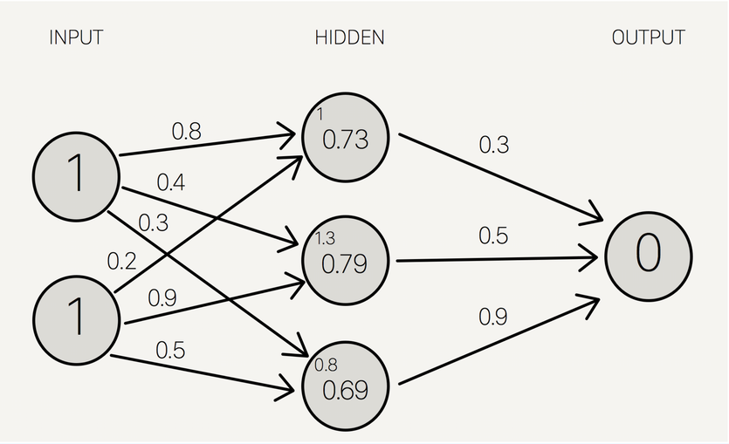
Neural Networks
Data forms the input layer
Engineers choose a loss/cost function to compare against the training labels
How close are we to predicting the right answers?
At each layer, inputs summed and passed to the next layer

Slide 40
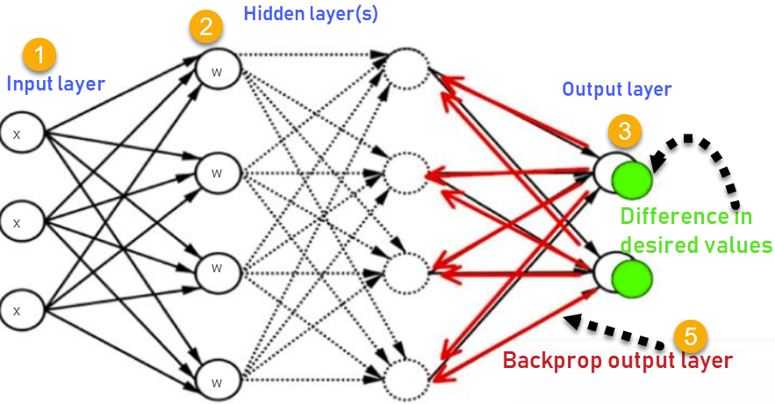
Backpropagation
Tuning the network

Slide 41
Neural Networks
Limited domain information embedded in the model
Substituting computation for expert knowledge
Great for tasks with a lack of domain understanding for feature extraction

Slide 42
Deep Learning
What is the role of the engineer?
Setting hyperparameter values — require engineering knowledge, but less domain knowledge
Epochs
Batch size
Learning rate
Regularization
Activation function
Number of hidden layers

Slide 43
Deep Learning
Workflow changes — we only need examples

Slide 44
AI Fundamentals
Limitations of Deep Learning
Prasanna (Sonny) Tambe, Associate Professor of Operations, Information and Decisions

Slide 45
Limitations of Deep Learning
Do you have plenty of varied training data available?
Deep learning is going to require much more training data than other approaches
Also need a lot of variation in the data
Do you have the necessary data storage and computational power available?
The hardware requirements of deep learning are much more significant
Do you need insight into why a deep learning model made a specific decision?
Lack of interpretability (explainability)

Slide 46
AI Fundamentals
Common Loss Functions
Prasanna (Sonny) Tambe, Associate Professor of Operations, Information and Decisions

Slide 47
Accuracy
Actual value | Predicted value
Legitimate | Legitimate
Fraudulent | Legitimate
Fraudulent | Fraudulent
Legitimate | Legitimate
Legitimate | Fraudulent
Legitimate | Legitimate
Fraudulent | Fraudulent
Fraudulent | Legitimate
Legitimate | Legitimate
Legitimate | Legitimate
Fraction of labels (answers) that the algorithm predicts correctly
Accuracy = 0.70
Classification error = 0.30

Slide 48
Precision
Actual value | Predicted value
Fraudulent | Fraudulent
Legitimate | Fraudulent
Legitimate | Legitimate
Fraudulent | Fraudulent
Fraudulent | Legitimate
Fraudulent | Fraudulent
Legitimate | Legitimate
Legitimate | Fraudulent
Fraudulent | Fraudulent
Fraudulent | Fraudulent
What proportion of positive identifications were actually correct?
If “fraudulent” is the positive class, what proportion of the ones we call fraudulent are actually fraudulent?
Precision = 5/7 = 0.71

Slide 49
Sensitivity (Recall)
Actual value | Predicted value
Fraudulent | Fraudulent
Legitimate | Fraudulent
Legitimate | Legitimate
Fraudulent | Fraudulent
Fraudulent | Legitimate
Fraudulent | Fraudulent
Legitimate | Legitimate
Legitimate | Fraudulent
Fraudulent | Fraudulent
Fraudulent | Fraudulent
How many relevant instances (fraudulent) did you catch?
Recall = 5/6 = 0.8333

Slide 50
Specificity
Actual value | Predicted value
Fraudulent | Fraudulent
Legitimate | Fraudulent
Legitimate | Legitimate
Fraudulent | Fraudulent
Fraudulent | Legitimate
Fraudulent | Fraudulent
Legitimate | Legitimate
Legitimate | Fraudulent
Fraudulent | Fraudulent
Fraudulent | Fraudulent
Proportion of legitimates correctly identified as such
Specificity = 2/4 = 0.50

Slide 51
Definitions: Type I and Type II Error
True positive
Fraction of times we identify a Fraudulent as a Fraudulent
True negative
Fraction of times we identify a Legitimate as a Legitimate
False positive
Fraction of times we identify a Legitimate as a Fraudulent
(Type I error)
False negative
Fraction of times we identify a Fraudulent as a Legitimate (Type II error)

Slide 52
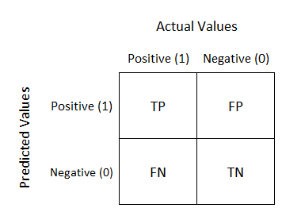
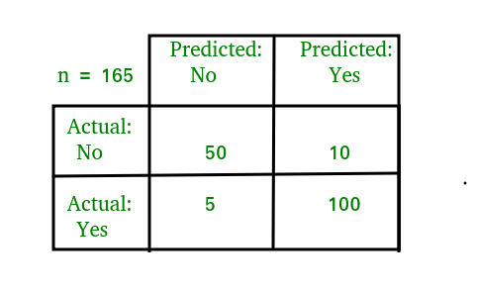
Confusion Matrix

Slide 53
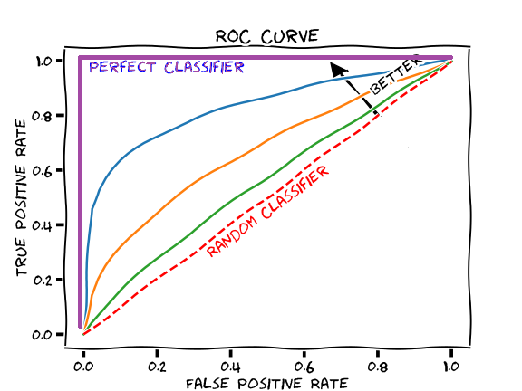
Receiver Operating Characteristic (ROC) Curve
ROC curves suggest a tradeoff

Slide 54
AI Fundamentals
Tradeoffs Between Loss Functions
Prasanna (Sonny) Tambe, Associate Professor of Operations, Information and Decisions

Slide 55
Tradeoffs Between Loss Functions
What are the relative costs of false negatives and false positives?

Slide 56
Tradeoffs Between Loss Functions
When might we want a sensitive test?
Medical application — screening for a disease
Want to make sure we don’t miss a person with the condition
Even at the potential cost of falsely identifying some cases as having the condition, even if they actually don’t
Radar system detecting incoming aircraft

Slide 57
Tradeoffs Between Loss Functions
When might we want a precise test?
When it’s okay for a car to take a left turn
Want to be absolutely sure that it is okay to take a left before recommending the decision to take a left
Even if it means we will miss some opportunities to take a left turn
Identifying violations that have severe punishments (e.g. cheating that leads to expulsion)

Slide 58
AI Fundamentals
How is Training Data Acquired?
Prasanna (Sonny) Tambe, Associate Professor of Operations, Information and Decisions

Slide 59
Training Data
The data that the algorithm uses to learn the best mapping between the inputs and the right predictions, or outputs

Slide 60
Training Data
Where does training data come from?
Archival, or historical, data in the organization
In many domains there are records of decisions that have been made that can be used to train a model
E.g. resume screening
Human data labeling to generate training data
Platforms for crowdsourcing the task of labeling data
Using customers to label data
Google and Gmail spam filtering
Social networks

Slide 61
AI Fundamentals
The Over-Fitting Problem
Prasanna (Sonny) Tambe, Associate Professor of Operations, Information and Decisions

Slide 62
Key to ML Algorithms
Training data is the key to building ML algorithms, but we care most about performance on out-of-sample data
The point is to predict outcomes where we don’t already know what is going to happen

Slide 63
The Over-Fitting Problem
Over-fitting is the danger that the model performs well on training data, but not other data sets
ML engineers try to avoid fitting the model to the point that it picks up noise in the training data
Trying to balance using the training data to build an accurate model, with having a model that still performs well on out-of-sample data
Example: Studying the test vs. studying the material

Slide 64
The Over-Fitting Problem
The challenge is in capturing the relevant aspects of the model vs. capturing the noise in the training data
This is called the “bias-variance” tradeoff

Slide 65
The “Bias-Variance” Tradeoff
Example: Customer targeting
Want to run a promotion where we target specific customers
Have training data based on a small set of customers who we’ve run the promotion on in the past
We’d like to run a model that picks up the relevant attributes of those customers that can be useful for predicting future customers who might be responsive
Could run the model to the point where it goes overboard and picks up noise in the data
E.g. first name “Julie” and promotion response

Slide 66
AI Fundamentals
Test Data
Prasanna (Sonny) Tambe, Associate Professor of Operations, Information and Decisions

Slide 67
Test Data
Test data (also called a “hold-out sample”) is a data set that is not used to train or build the model, but can be used to validate the model
Validating performance on a data set that’s not used to build the model (test data) helps ensure the model also works well on outside samples

Slide 68
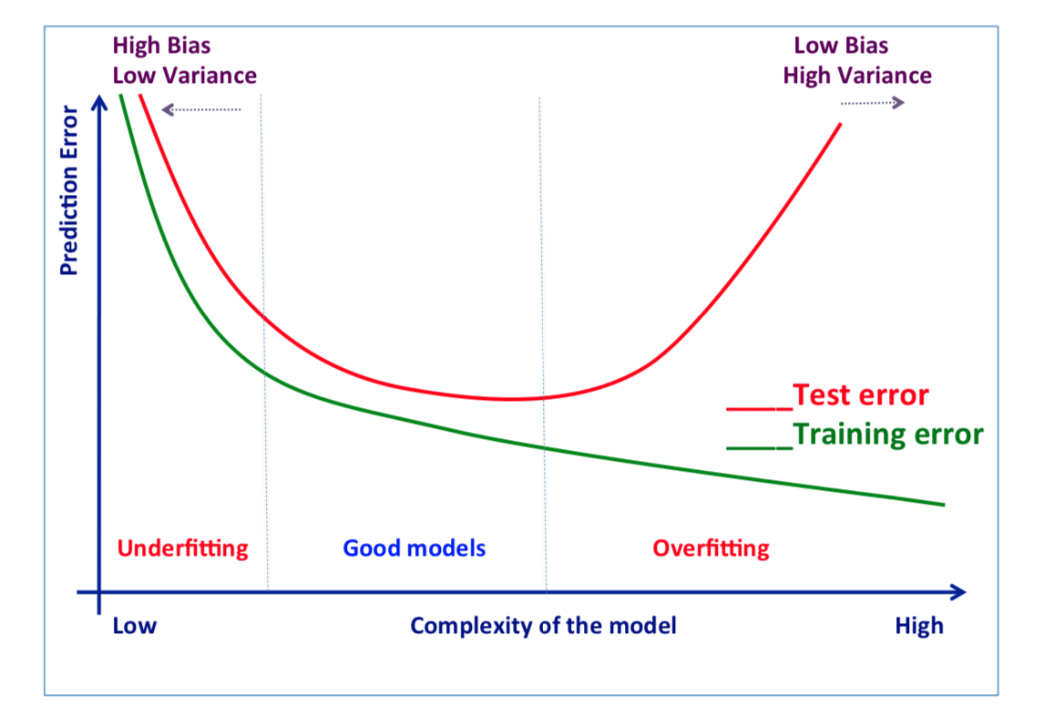
Performance Tradeoffs with Training and Test Data

Slide 69
Where Does Test Data Come From?
One common approach is for ML engineers to start with all of the data for which they have labels, and then divide it up into training and test data (e.g. conduct a 70/30 split)
Example: Insurance data to predict accident likelihood
Take all historical data and divide it up
Everything up until the last 6 months is used as training data
Everything from 6 months ago to the present day is used as test data

Slide 70
AI Fundamentals
Examples of End-to-End AI Workflow
Prasanna (Sonny) Tambe, Associate Professor of Operations, Information and Decisions

Slide 71
End-to-End AI Workflow
ML to identify disease in medical images
Collect large amounts of data on medical diagnostic images with expert decisions (e.g. from radiologists)
These experts have labeled these images as indicating a condition or not
Build the model on a training sample and evaluating performance on test samples
The machine can be taught to predict with accuracy, given a medical image, whether someone has a condition
Key point — never had to ask anyone to describe what aspects of medical images suggest a condition
No need to talk to a medical expert/radiologist

Slide 72
Magic of Machine Learning
Data and computation substitute for expertise
Advantages
Consistency
Scale/speed
Works really well for some tasks
Faster/cheaper to build

Slide 73


